Slide 1
UI Wire Frame - Bus Ticket Booking System

Slide 2
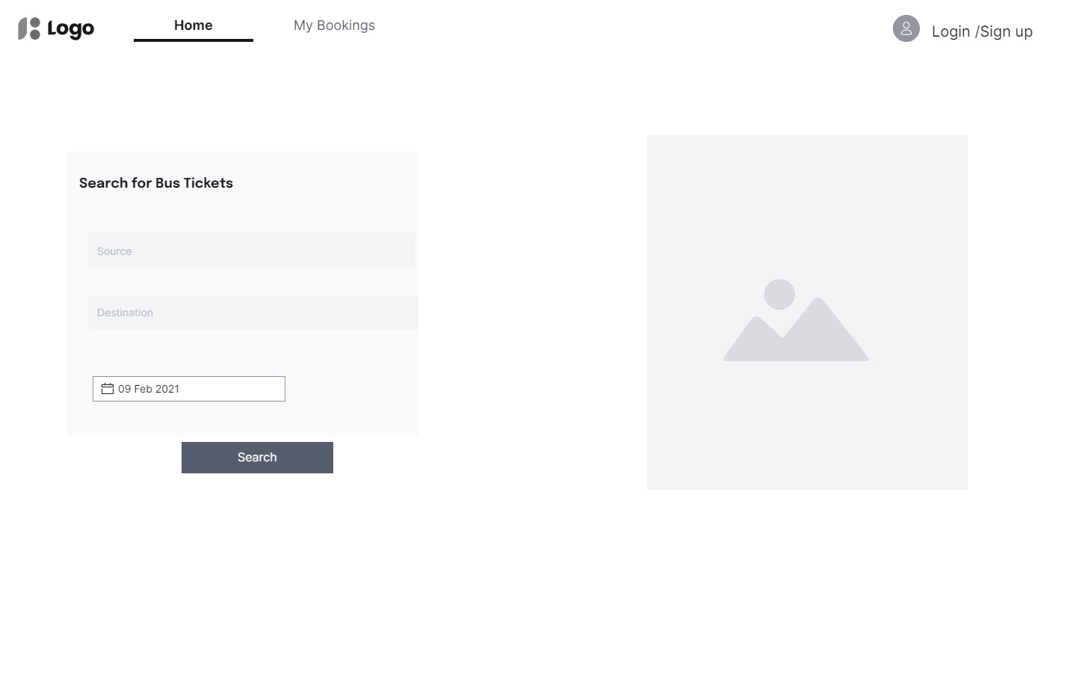
Main Page

Slide 3
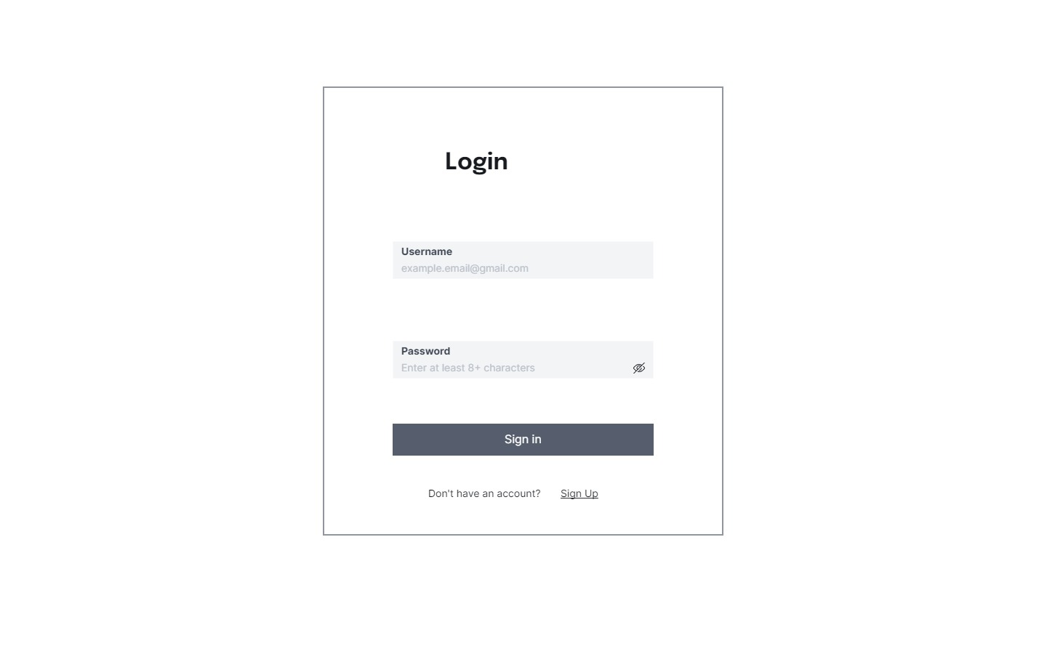
Login Page(Admin and User)

Slide 4
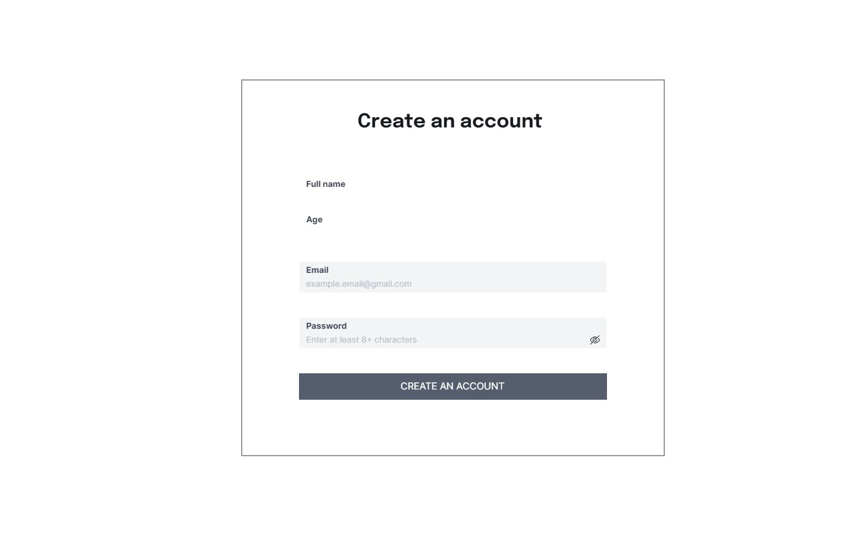
Sign Up Page(User)

Slide 5
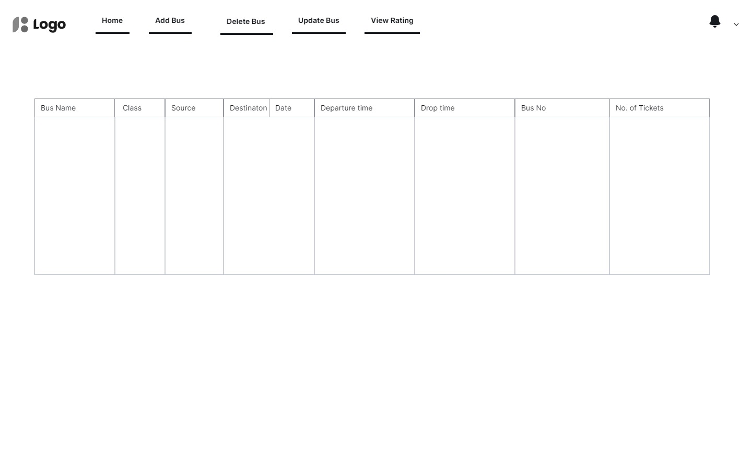
View(Admin)

Slide 6
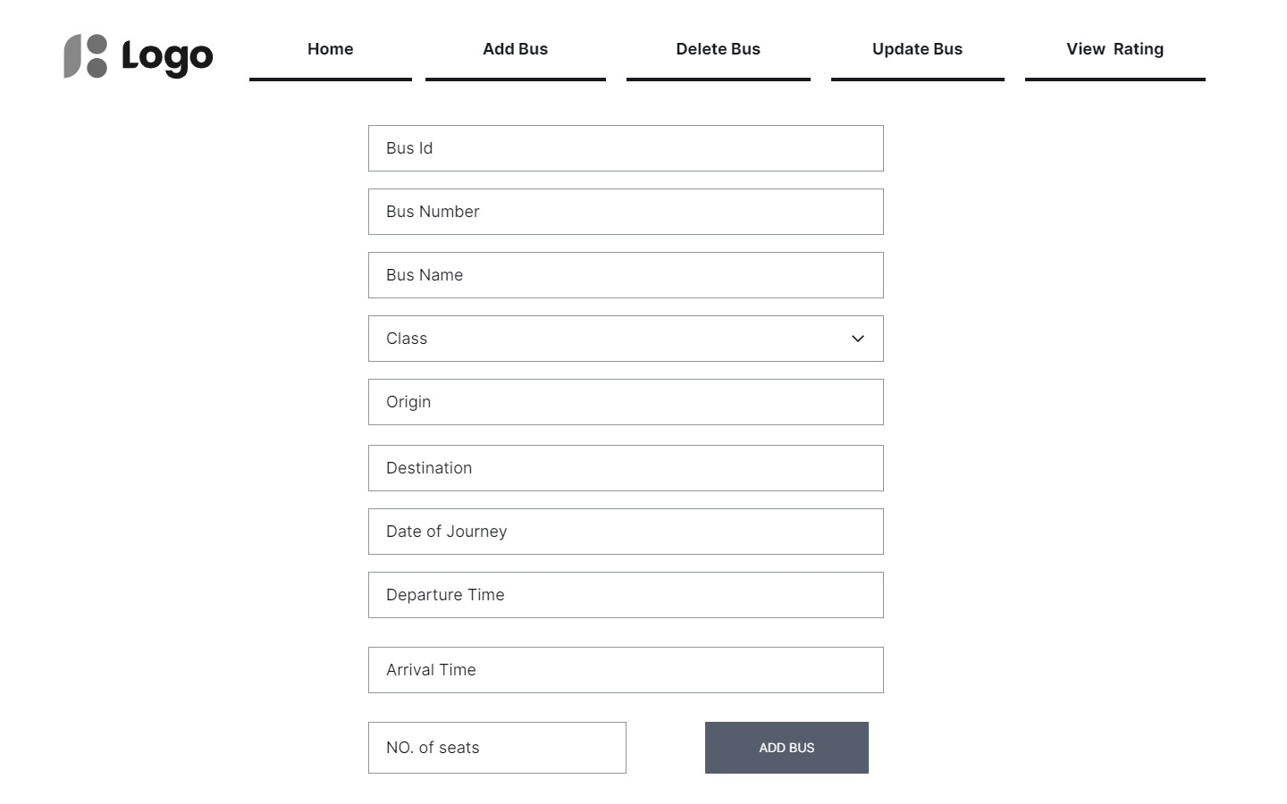
Add Bus(Admin)

Slide 7
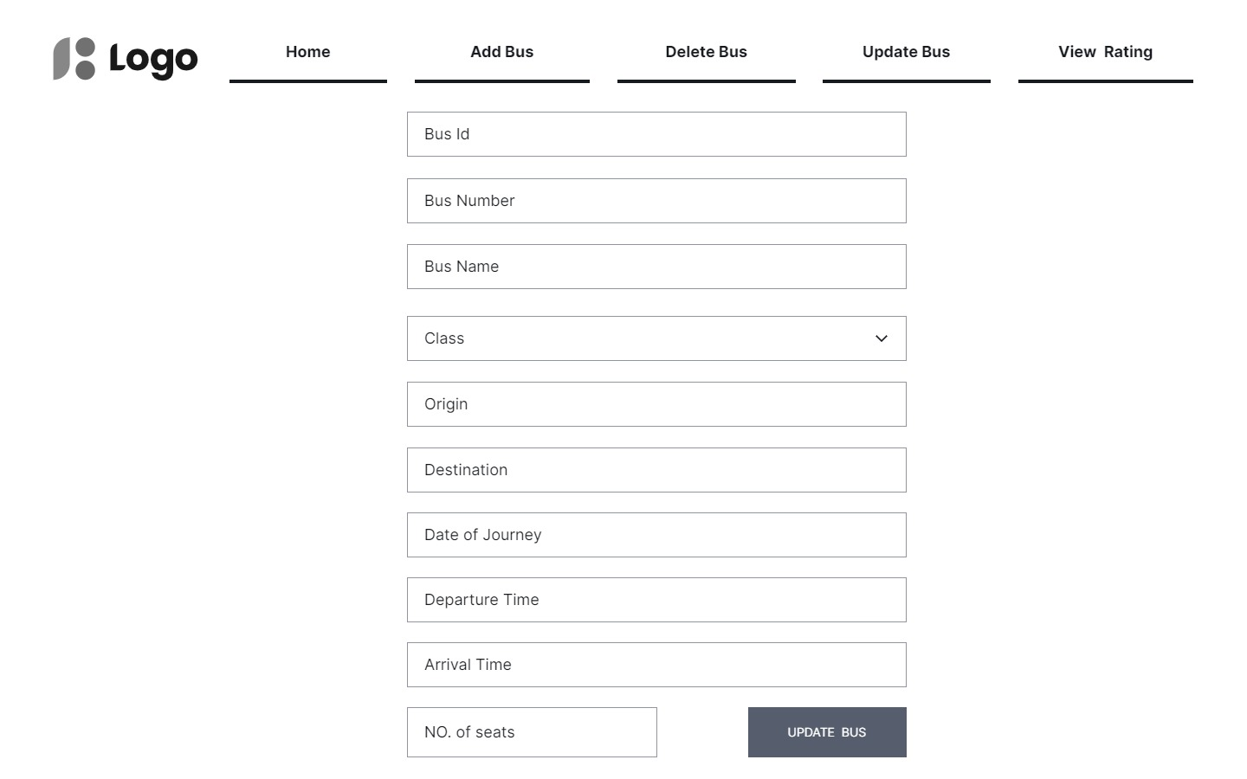
Update Bus(Admin)

Slide 8
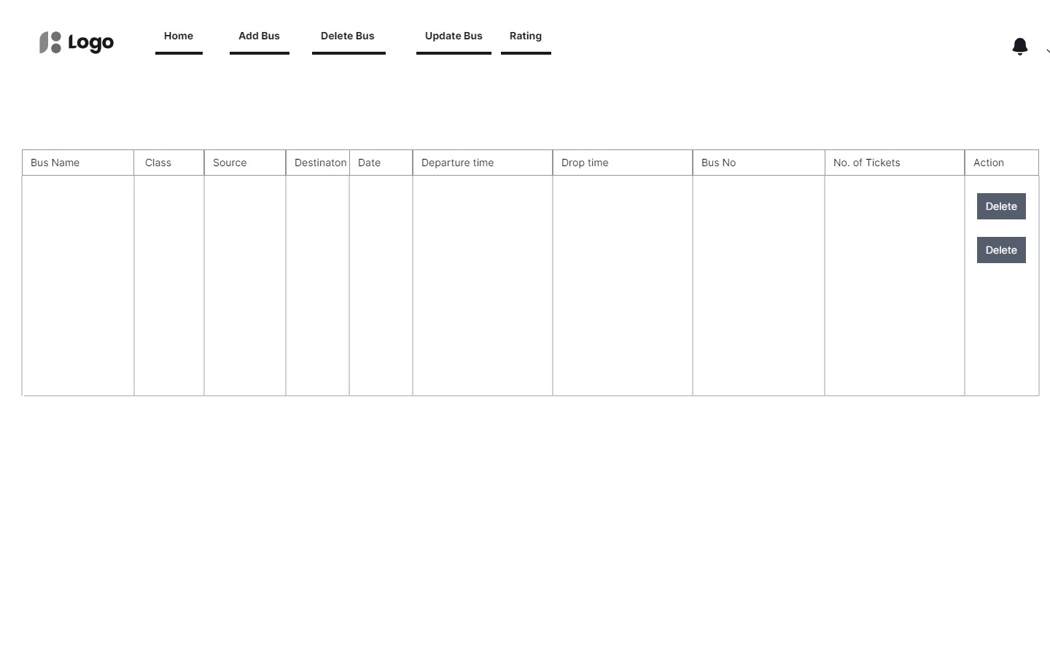
Delete Bus(Admin)

Slide 9
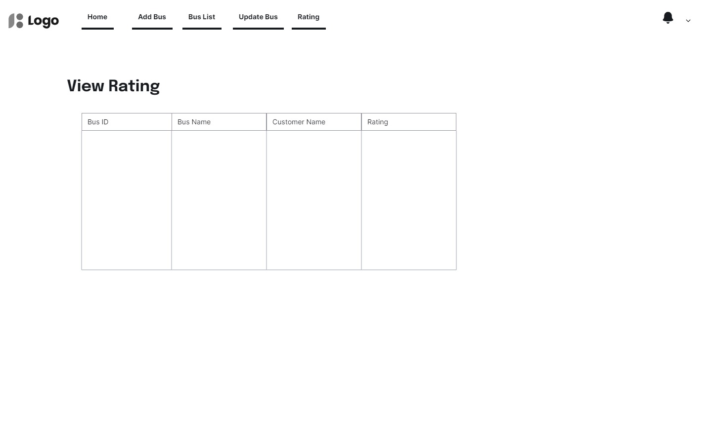
View Rating(Admin)

Slide 10
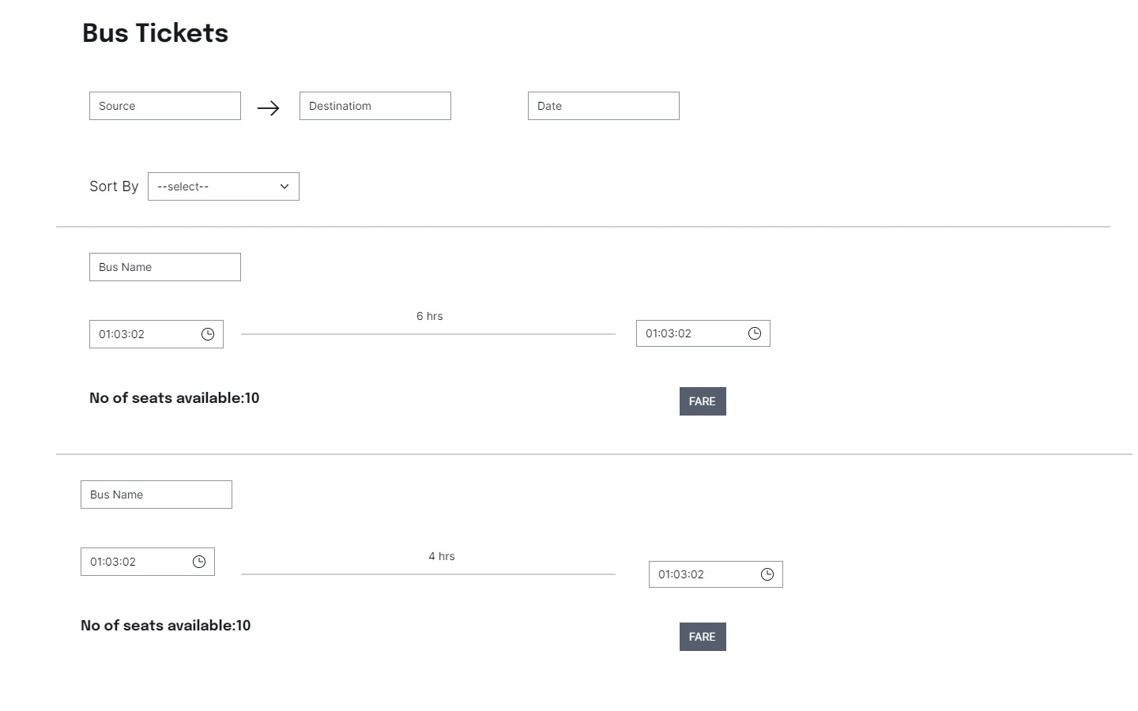
Search Tickets(User)

Slide 11
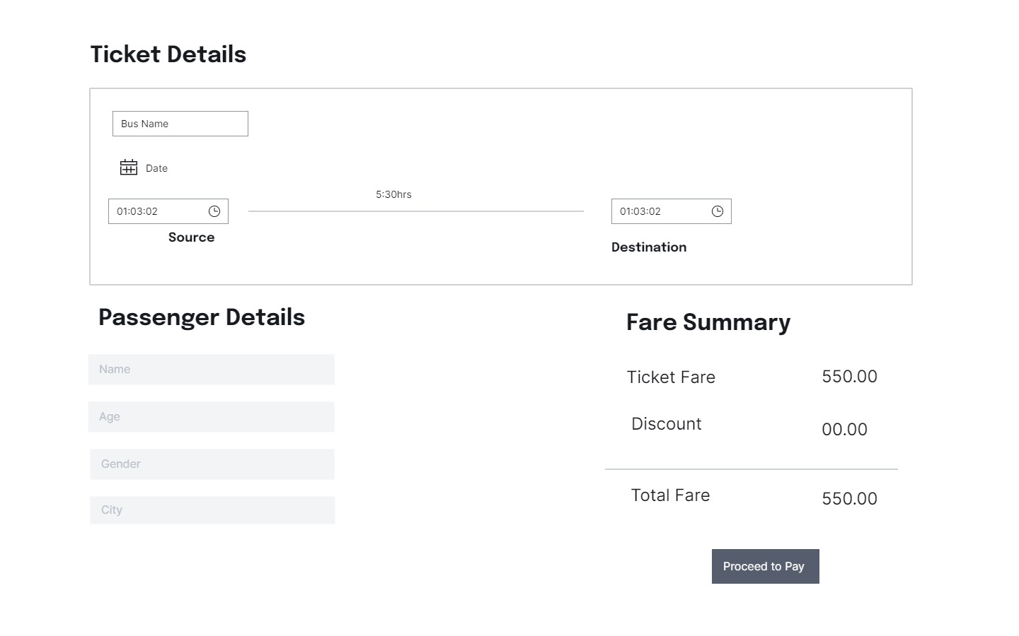
Ticket Booking(User)

Slide 12
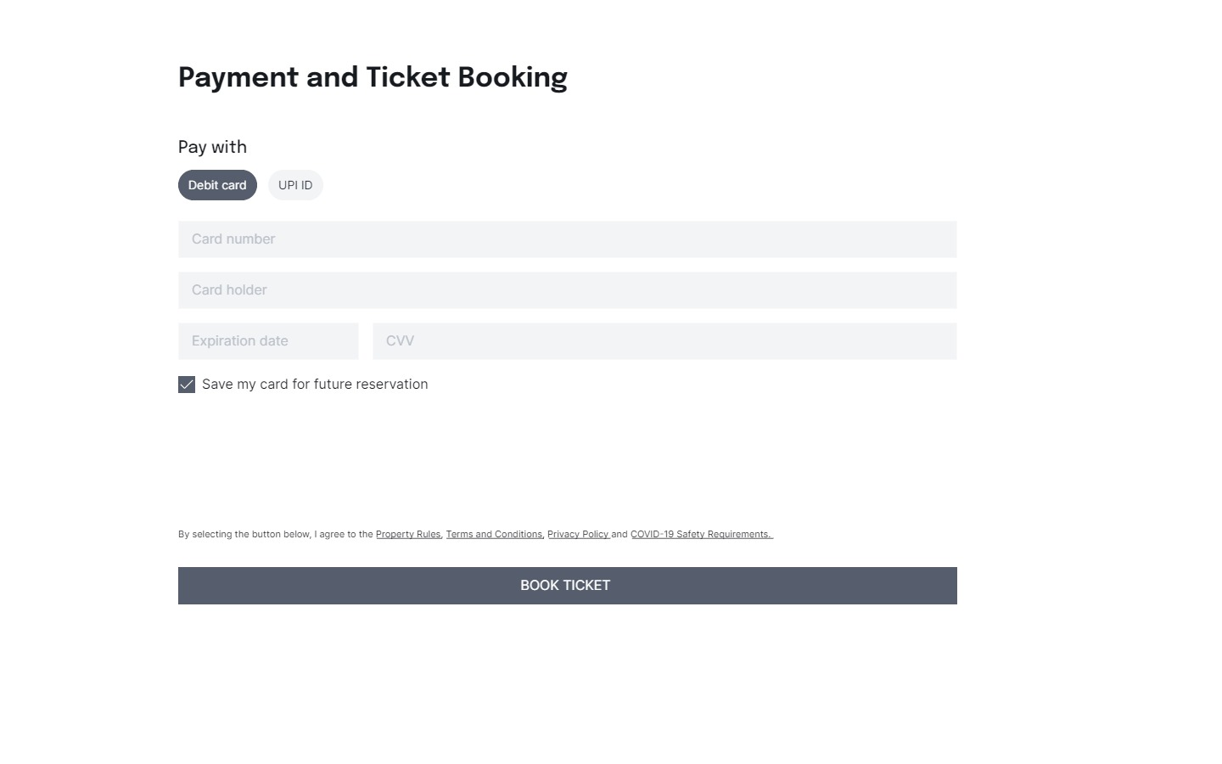
Payment(User)

Slide 13
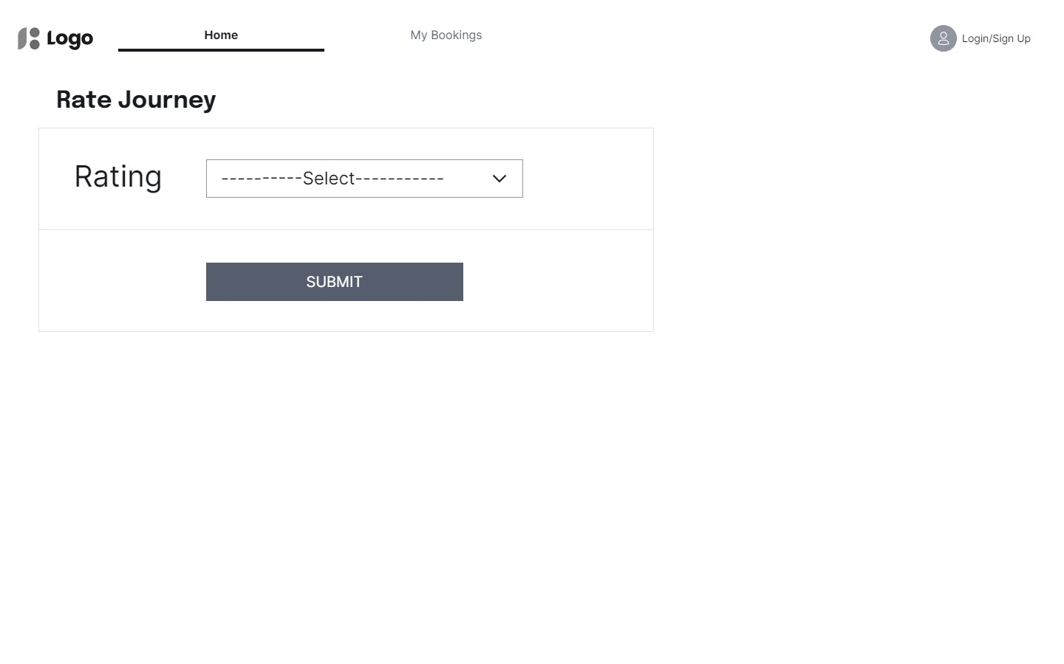
Rating(User)

